Slide 1
Representational State Transfer

Slide 2
Definition
An architectural style for providing standards between computer systems on the web, making it easier for systems to communicate with each other

Slide 3
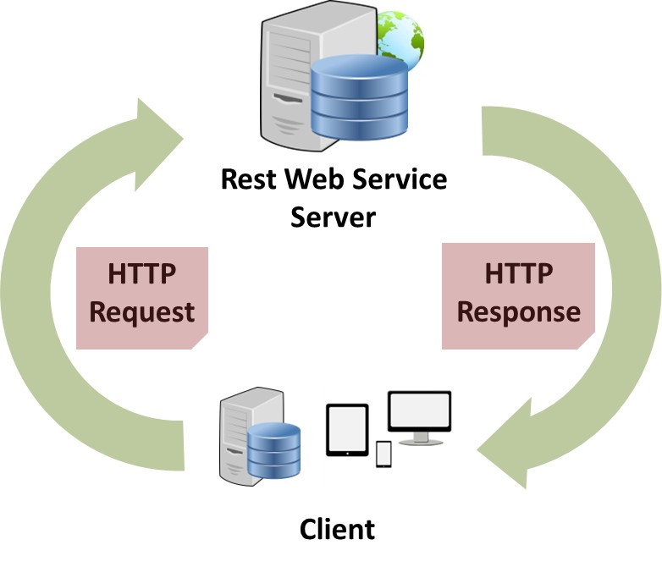

Slide 4
Role in Modern Web Applications

Slide 5
Builds upon existing systems and features of HTTP in order to achieve its objectives, as opposed to creating new standards, frameworks and technologies

Slide 6
Relationship between HTTP messages and REST

Slide 7
Interactions happen using constructs using standard HTTP status codes
Reliance on SSL (Secure Sockets Layer) and TLS (Transport Layer Security)

Slide 8
Key Features

Slide 9
Separation of client and server side changes from each other
Pervasiveness
Applications can be written using any language as long as it can make web-based requests

Slide 10
HTTP verbs

Slide 11
GET
Retrieve a specific resource (by id) or collection of resources
POST
Create a new resource
PUT
Update a specific resource (by id)
DELETE
Remove a specific resource by id

Slide 12
Stateless client/server protocol

Slide 13
The server and the client does not need to know anything about what state the client is in and vice versa. This is enforced by the use of resources instead of commands.

Slide 14
Resources
Mane, S. (2017, June 8). understanding-rest-representational-state-transfer-85256b9424aa. Retrieved from medium.com/@sagar.mane006: https://medium.com/@sagar.mane006/understanding-rest-representational-state-transfer-85256b9424aa
Rouse, M. (n.d.). TechTarget. Retrieved from TechTarge.com: https://searchapparchitecture.techtarget.com/definition/REST-REpresentational-State-Transfer
what-is-rest. (n.d.). Retrieved from codecademy.com: https://www.codecademy.com/articles/what-is-rest

